Slide 1
Polar Heart Rate Sensors
By: Colton Bormann
Shane Collins
Austin Lloyd

Slide 2
Polar Go-Fit Heart Rate Monitor Video
VIDEO

Slide 3
Polar Go Fit Heart Sensors
Easy way to follow your student’s heart rates online during a P.E. lesson.
Intended to be used in physical education environment
You can view this data for individual students or for the entire class.
Allows you to alter the structure of your lesson in response to instant feedback from your students.
Easy an fun way for students to learn about health benefits on staying in different target heart rate zones.
You can see summary data after the lesson and compare all ongoing courses that you have.
Data saves automatically at polargofit.com for later analysis and evaluation.
Only requires an IPad with the polar go-fit app and a user account at polargofit.com.
Cost: $38.99

Slide 4
Polar Go Fit Pro’s and Con’s
Pros
App is FREE for the device
Data saves automatically at polargofit.com
Easy way to track students heart rates
Instant feedback
Wireless
Fun for students
Cons
Have to send it back to the manufacturer when batteries die.
Uncomfortable
Sanitary concerns
Require moisture to get an accurate read

Slide 5
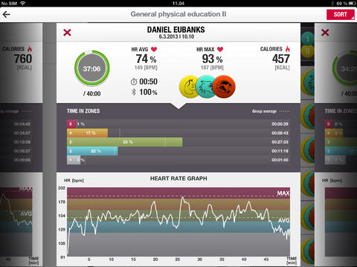
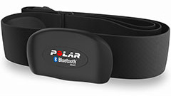
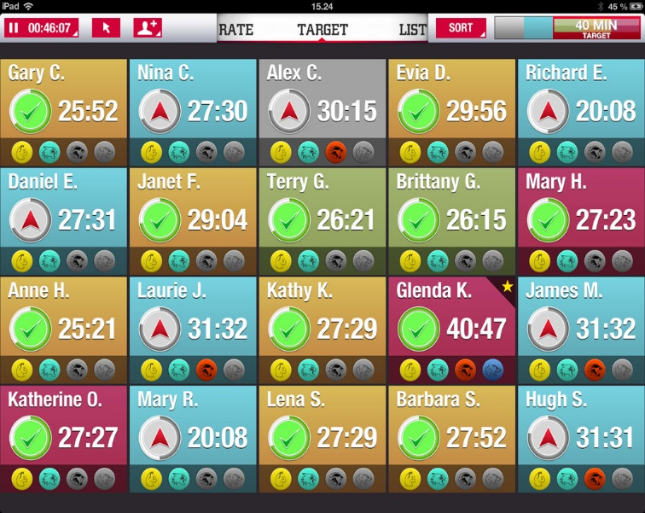
Polar Go Fit Heart Rate Sensors

Slide 6
Acumen Heart Rate Monitor
Comes in 3 models ranging from $70-$230
Personal use
Wrist watch
Standard heart rate monitor
Visual and audible alarms
Tells you the time spent above, within, and below target zone, along with total exercise time
Calorie counter
Water resistant up to 30 meters

Slide 7
Acumen Heart Rate Monitor Pro’s and Con’s
Pro’s
Easy to set up
Waterproof
Wear like a wrist watch
Easy to view
No other technology required
Con’s
A little large for a smaller wrist
Calorie counter is not very accurate
Not very durable
Expensive for what it does

Slide 8
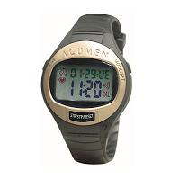
Acumen Heart Rate Monitor

Slide 9
Garmin Heart Rate Monitors
One size fits all.
Personal use.
Intended for personal use to track heart rate during exercise.
The strap is linked to your Garmin watch that you purchase with the system.
Watch displays information to you while you are exercising.
Price differs from the watch that you have synced to the strap.
Basic model runs around $100
The two devices that you are using need to be synced before use.

Slide 10
Garmin Heart Rate Monitor Pro’s and Con’s
Pros
One size fits all
Wireless
Made of soft fabric
User friendly
Heart monitor around chest gives accurate read
Cons
Only for Android
Buy watch which increases price
Uses battery
Needs to be washed
Needs moisture to accurately read heart rate

Slide 11
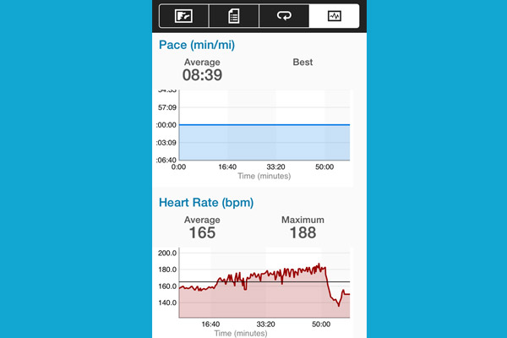
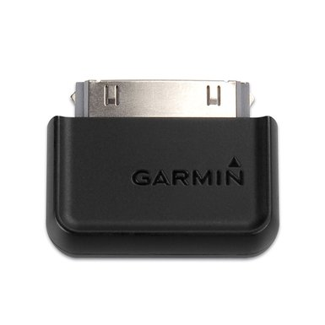
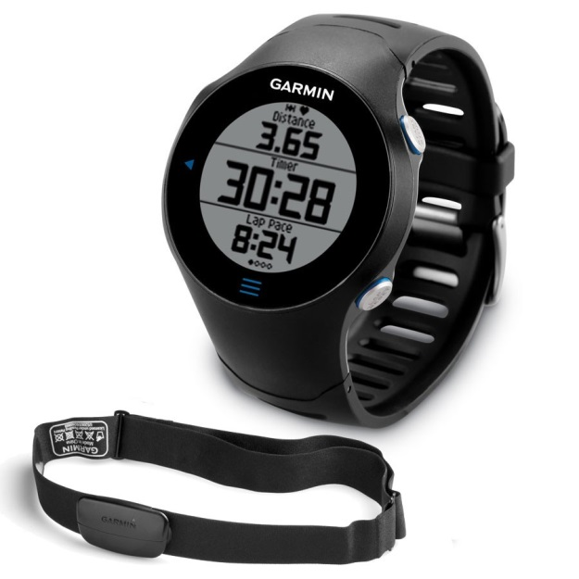
Garmin Heart Rate Monitor

Slide 12
Timex Heart Rate Monitor
Cost $64.
Personal use
Comes with chest strap and wrist watch.
Watch and Device on strap sync with each other.
Able to view your results on your watch as you are working out.
Able to look at a workout review when you are done.
Automatic activity timer so you don’t have to worry about setting it up before every workout
Has a recovery heart rate timer to show how long it takes for you heart rate to get back down to normal.
Shows calories burned

Slide 13
Timex Heart Rate Monitor Pro’s and Con’s
Pro’s
Automatically syncs up
Easy set up
Easy to view
24 hour wristwatch
Alarm system
Accurate heart rate read
Decently priced
Con’s
Uncomfortable chest strap
No app, have to view results on wrist watch
Recommended to wash chest strap after use
Requires moisture to get accurate read

Slide 14
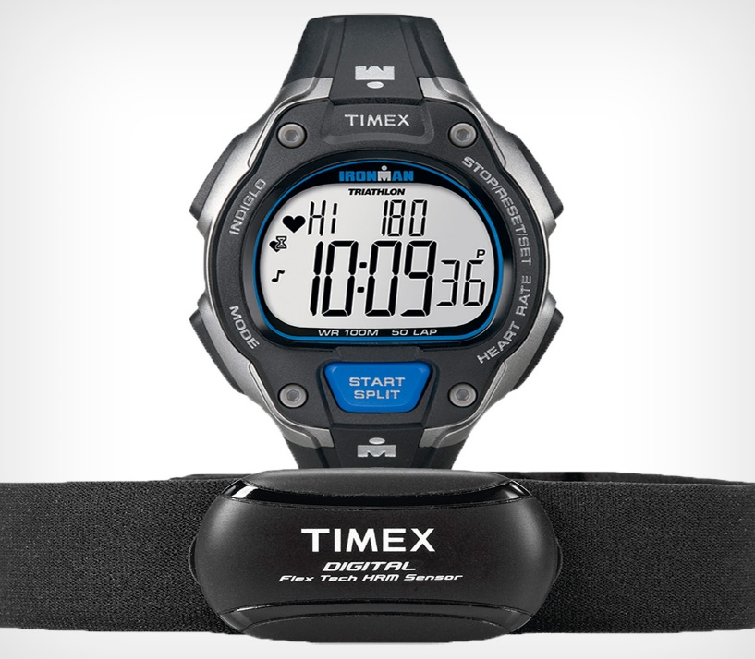
Timex Heart Rate Monitor

Slide 15
Suunto Heart Rate Monitor
Water resistant up to 50 meters.
Personal use
Battery life is 14 days.
Shows time and date and has an alarm feature.
Measures heart rate.
Shows the number of calories burned.
Can be used specifically for running, cycling, and swimming.
Cost $280-$500
Comes with strap and watch set.

Slide 16
Suunto Heart Rate Monitor Pro’s and Con’s
Pro’s
Has a ton of features
Extremely accurate
Long battery life
Water resistant
Updates
Con’s
Expensive
No wireless sync to PC
No way to import moves to other sources
Charge cable is poorly built
Once deleted you can’t re-upload to move account

Slide 17
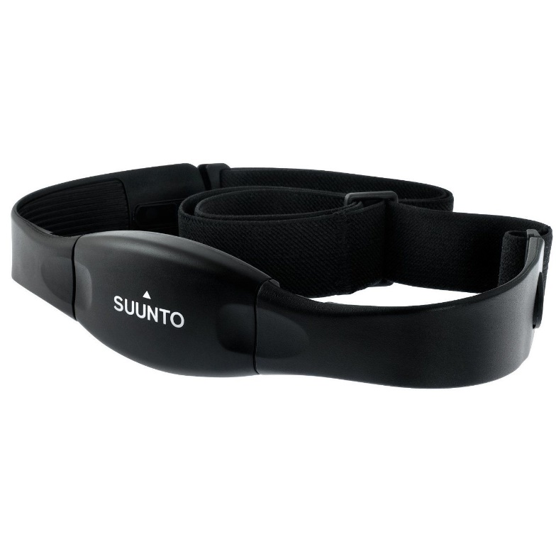
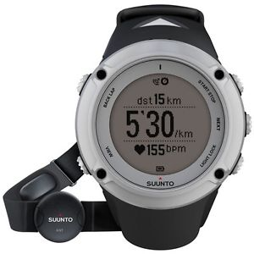
Suunto Heart Rate Monitor

Slide 18
Consumer Report
 | Polar Go-Fit | Acumen | Garmin | Timex | Suunto
Website | Polargofit.com | Acumeninc .com | Buy.garmin .com | Timex.com | Suunto.com
Style | Chest Strap/Device | Wrist Watch | Watch&Chest Strap | Watch&Chest Strap | Watch&Chest Strap
App | YES | NO | YES | NO | YES
Color Options | YES | YES | YES | YES | YES
Classroom Friendly | YES | NO | YES | NO | NO
Calories Burned | YES | YES | NO | YES | YES
Steps/Distance | NO | YES | NO | YES | YES

Slide 19
 | Polar Go-Fit | Acumen | Garmin | Timex | Suunto
Wireless Sync | YES | NO | YES | YES | YES
Water Resistant | NO | YES | NO | NO | YES
Battery | YES | YES | YES | YES | YES
Clock | NO | YES | YES | YES | YES
Memory | YES | NO | YES | NO | YES
Online Tools | YES | NO | YES | YES | YES
Price | $38.99 | $70-$230 | $100 | $64 | $280-$500

Slide 20
Overall Recommendation
After viewing all of these heart rate monitors, the only one of these that would make sense in a physical education environment would be the Polar Go-Fit Sensor. This device would be very affective in a P.E. class with the use of Bluetooth technology to give all of the students real time feedback so they are able to reach their goal every class period.

